Slide 1



Department of Computer Science and Engineering
CEREBRAL STROKE CLASSIFICATION USING SUPERVISED LEARNING APPROACHES
KAVILASH R 211420104126 NAVEEN KUMAR N 211420104179 NAVEEN S 211420104178
Mr. M.Mahendran,
M.TECH.
Dr. G.Senthil Kumar, M.C.A.,M.Phil.,M.B.A., M.E., Ph.D

Slide 2
Abstract:
Cerebral stroke is a life-threatening medical condition that requires immediate diagnosis and intervention to minimize its devastating effects. Timely and accurate classification of stroke subtypes is crucial for determining appropriate treatment strategies and improving patient outcomes. In this research, we explore the application of supervised learning approaches to classify cerebral stroke subtypes based on relevant medical data. The study involves the collection of a diverse dataset comprising anonymized patient records, including clinical indicators, medical history, risk factors, and diagnostic imaging results. The data is carefully pre-processed to handle missing values, normalize numerical features, and address any potential biases. The experimental results demonstrate the effectiveness of supervised learning approaches in accurately classifying cerebral stroke subtypes.

Slide 3
Introduction
Strokes are medical emergencies that occur when something goes wrong with the blood supply to the brain.
Understanding the complex pathophysiology of cerebral stroke is crucial for developing effective prevention, treatment, and rehabilitation approaches.
Strokes are broadly categorized into two main types:
Ischemic Stroke:
Ischemic strokes occur when a blood clot or plaque blocks an artery, reducing or completely cutting off blood flow to a part of the brain.
Hemorrhagic Stroke:
Hemorrhagic strokes occur when a weakened blood vessel ruptures, causing bleeding into or around the brain.

Slide 4
AIM AND OBJECTIVE:
AIM:
Stroke prediction is essential and must be treated promptly to avoid irreversible damage or death. With the development of technology in the medical sector, it is now possible to anticipate the onset of a stroke by utilizing ML techniques So this project can easily find out the Attack.
Objectives:
The goal of this study is to develop a novel decision-making tool for predicting strokes. This study compares the accuracy, precision, and execution time of convolution neural networks, densenet, and VGG 16 for stroke prediction. The performance of the CNN classifier is superior than Densent and VGG 16, according to the findings of the experiments.

Slide 5
Existing System
Neural-like P systems are membrane computing models inspired by natural computing and are viewed as third-generation neural network models. Although real neurons have complex structures, classical neural-like P systems simplify the structures and corresponding mechanisms tree-based firing and forgetting communications, which limit the real applications of these models. In this paper, we propose a hypergraph-based numerical neural-like (HNN) P system containing five types of neurons to describe the high-order correlations among neuron structures.
Three new kinds of communication mechanisms among neurons are also proposed to address numerical variables and functions.Based on the new neural-like P system, a tumor/organ segmentation model for medical images is developed. The experimental results indicate that the proposed models outperform the state-of-the-art methods based on two hippocampal datasets and a multiple brain metastases dataset, thus verifying the effectiveness of the HNN P system in correctly segmenting tumors/organs.

Slide 6
Existing System
Advantages:
1. Versatility
2. Implicit Feature Selection
Disadvantages:
1. They did not implement the deployment process.
2. They only disease segmentation.
3. Accuracy & performance was low.
4. They did not using machine learning techniques.

Slide 7
Proposed System
The proposed system aims to enhance network security by predicting and pre-emptively detecting various types of network attacks using supervised machine learning techniques. The system leverages a diverse dataset of network traffic, comprising both normal and attack instances, to develop an efficient predictive model.
The first step involves collecting a comprehensive dataset of network traffic. This dataset should include normal network traffic as well as instances of various attack types, such as DDoS attacks, intrusion attempts, malware activity, etc. The data is then pre-processed to handle missing values, normalize numerical features, and encode categorical variables.
Several supervised machine learning algorithms are considered for the predictive model. Popular algorithms like Decision Trees, Random Forests, Support Vector Machines (SVM), Neural Networks, and K-Nearest Neighbours (KNN) are evaluated and compared based on their performance metrics using cross-validation techniques.

Slide 8
Proposed System
Advantages:
We build framework based application for deployment purposes.
We using machine learning techniques to build a predictive model.
Accuracy & performance level improved.
We implemented the Data analysis process by using histograms, Plots, and Graphs.
We compared more than two algorithms to get a better accuracy level.

Slide 9
Literature Review
Title : Brain Stroke Prediction Using Machine Learning Approach
Author: DR. AMOL K. KADAM1 , PRIYANKA AGARWAL2
Year : 2022
A Stroke is an ailment that causes harm by tearing the veins in the mind. Stroke may likewise happen when there is a stop in the blood stream and different supplements to the mind. As per the WHO, the World Health Organization, stroke is one of the world's driving reasons for death and incapacity. The majority of the work has been completed on heart stroke forecast however not many works show the gamble of a cerebrum stroke. Subsequently, the AI models are worked to foresee the chance of cerebrum stroke. The project is pointed towards distinguishing the familiarity with being in danger of stroke and its determinant factors amongst victims.

Slide 10
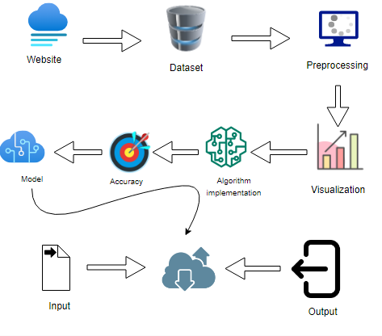
System Architecture:

Slide 11
Software / Hardware used
1.SOFTWARE REQUIREMENTS
Operating System : Windows
Tools : Jupyter Notebook, Visula studio code
2. HARDWARE REQUIREMENTS:
Processor : Pentium IV/III
Hard disk : minimum 100 GB
RAM : minimum 4 GB

Slide 12
LIST OF MODULES:
Data Pre-processing
Data Analysis of Visualization
Implementing Algorithm 1
Implementing Algorithm 2
Implementing Algorithm 3
Deployment

Slide 13
MODULE DESCRIPTION
Data Pre-processing:
Validation techniques in machine learning are used to get the error rate of the Machine Learning (ML) model, which can be considered as close to the true error rate of the dataset. If the data volume is large enough to be representative of the population, you may not need the validation techniques. However, in real-world scenarios, to work with samples of data that may not be a true representative of the population of given dataset.
To finding the missing value, duplicate value and description of data type whether it is float variable or integer. The sample of data used to provide an unbiased evaluation of a model fit on the training dataset while tuning model hyper parameters.

Slide 14
Data visualization
Data visualization is an important skill in applied statistics and machine learning. Statistics does indeed focus on quantitative descriptions and estimations of data. Data visualization provides an important suite of tools for gaining a qualitative understanding.
This can be helpful when exploring and getting to know a dataset and can help with identifying patterns, corrupt data, outliers, and much more. With a little domain knowledge, data visualizations can be used to express and demonstrate key relationships in plots and charts that are more visceral and stakeholders than measures of association or significance.
Data visualization and exploratory data analysis are whole fields themselves and it will recommend a deeper dive into some the books mentioned at the end.

Slide 15
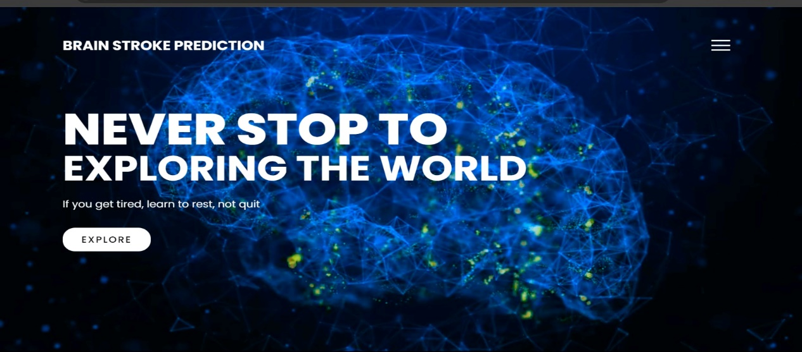
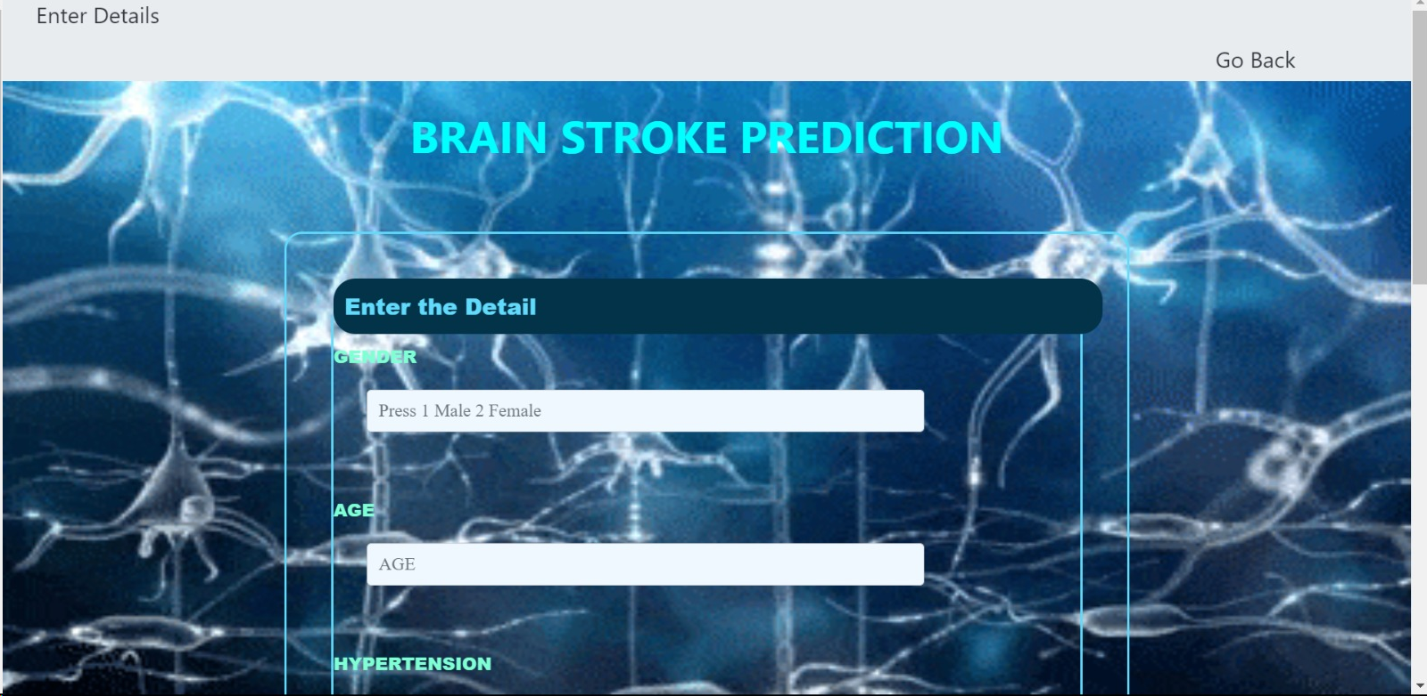
Screen Shots

Slide 16
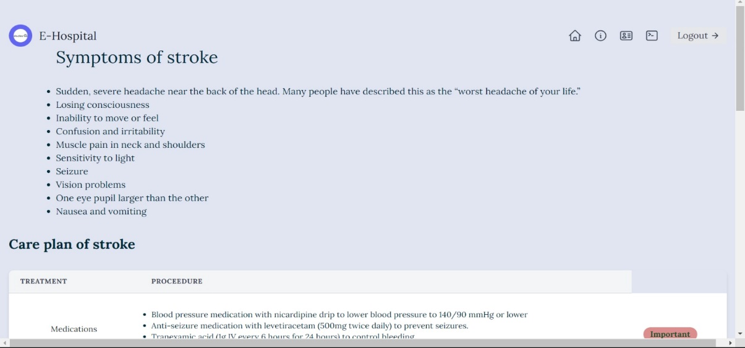
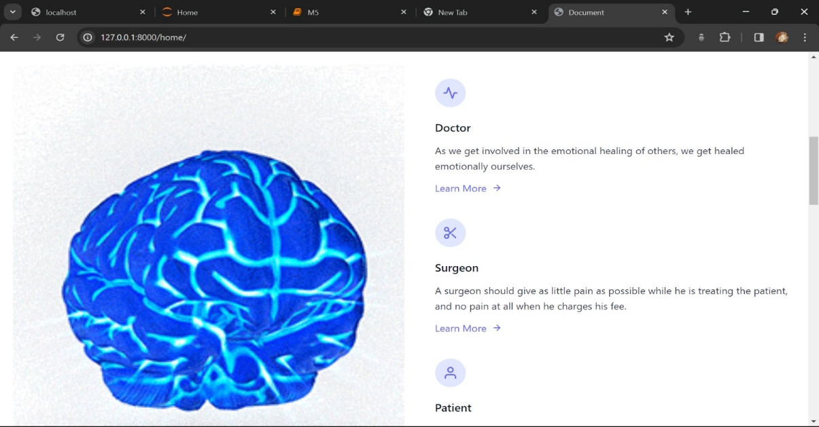
Screen Shots

Slide 17
Conclusion:
After the literature survey, we came to know various pros and cons of different research papers and thus, proposed a system that helps to predict brain strokes in a cost effective and efficient way by taking few inputs from the user side and predicting accurate results with the help of trained Machine Learning algorithms.
Thus, the Brain Stroke Prediction system has been implemented using the Machine Learning algorithm given a Best accuracy .
The system is therefore designed providing simple yet efficient User Interface design with an empathetic approach towards their users and patients.

Slide 18
Future Work
The added background knowledge from other datasets can also possibly improve the accuracy of stroke prediction models as well.
We intend to collect our institutional dataset for further benchmarking of these machine learning methods for stroke prediction.
We also plan to perform external validation of our proposed method, as a part of our upcoming planned work.
Implement multidisciplinary stroke care teams to provide comprehensive and coordinated management from acute treatment to rehabilitation.
Explore telemedicine and remote monitoring technologies to improve access to stroke care, particularly in underserved areas.

Slide 19
Reference Paper/ URL
Y. Zhang et al., "Automatic Detection of Cerebral Stroke from MRI Images Using Deep Learning," in IEEE Transactions on MedicalImaging, vol. 39, no. 8, pp. 2676- 2687, Aug. 2020.
S. Gupta et al., "Real-time Monitoring of Cerebral Stroke Using Wireless Sensor Networks," in IEEE Transactions on Biomedical Engineering, vol. 66, pp. 786- 794, March 2019.
H. Kim et al., "Detection of Early Signs of Cerebral Stroke Using Wearable EEG Devices," in IEEE Sensors Journal, vol. 20, no. 10, pp. 5496-5504, May 2020.
R. Patel et al., "An IoT-Based Smart System for Remote Monitoring and Diagnosis of Cerebral Stroke," in IEEE Internet of Things Journal, vol. 7, no. 6,pp. 5037- 5046, June 2020.
A. Sharma et al., "Deep Reinforcement Learning for Decision Support in Cerebral StrokeTreatment," in IEEE Transactions on NeuralNetworks, vol. 32, no. 9, pp. 3821-3832, Sept. 2021

Slide 20
THANK YOU

